Slide 1
Formal verification of P Systems Using NuSMV
Luculescu Teodor - 351
Mihalache Sebastian-Ștefan - 352
Neculae Andrei-Fabian - 352

Slide 2
Cuprins
TODO
Operația de împărțire
Numerele Fibonacci
TODO
Link Github - https://github.com/Andrei137/Proiect-MFIS

Slide 3
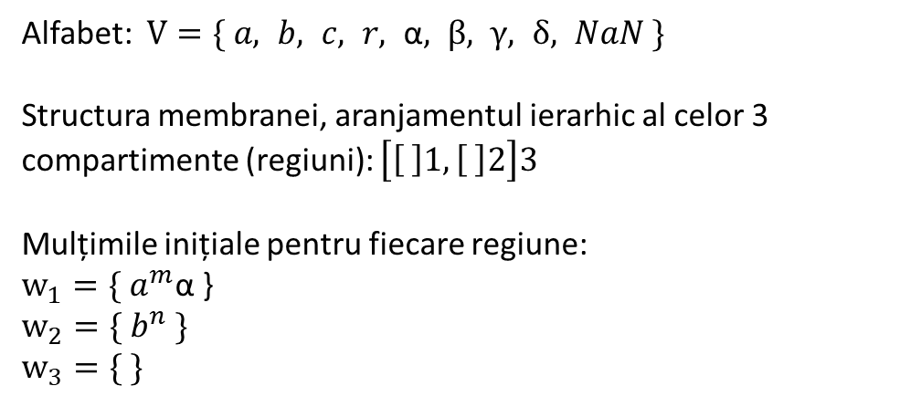
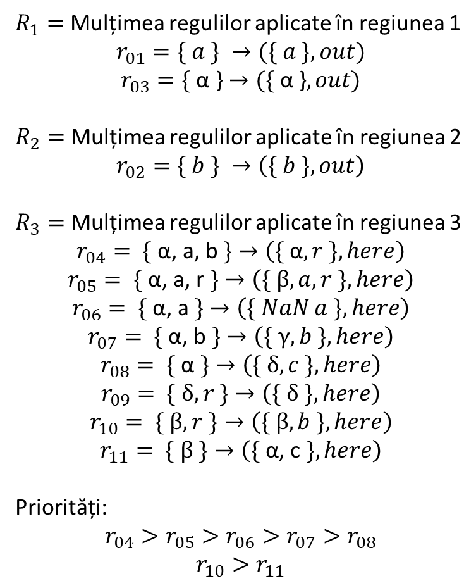


Reprezentarea operații de împărțire
Alfabet: $V=\{ a, b, c, r, \text{α}, β, γ, δ, NaN \}$
Structura membranei, aranjamentul ierarhic al celor 3 compartimente (regiuni): $\left[\left[ \right]1, \left[ \right]2\right]3$
Mulțimile inițiale pentru fiecare regiune:
$$w_{1}={\{ a}^{m}\text{α}\text{ \}}$$
$$w_{2}={\{ b}^{n} \}$$
$$w_{3}=\{ \}$$
$R_{1}=$ Mulțimea regulilor aplicate în regiunea 1
$$r_{01}=\{ a \} →(\{ a \}, out)$$
$$r_{03}=\text{\{ }\text{α}\text{ \}}→(\text{\{ }\text{α}\text{ \}}, out)$$
$R_{2}=$ Mulțimea regulilor aplicate în regiunea 2
$$r_{02}=\{ b \} →\left(\{ b \}, out\right)$$
$R_{3}=$ Mulțimea regulilor aplicate în regiunea 3
$$r_{04}=\text{ \{ }\text{α}\text{, }\text{a}\text{, }\text{b} \text{\}}→\left(\{ \text{α}, r \}, here\right)$$
$$r_{05}=\text{ \{ }\text{α}\text{, }\text{a}\text{, }\text{r} \text{\}}→\left(\{ β, a,r \}, here\right)$$
$$r_{06}=\text{ \{ }\text{α}\text{, }\text{a} \text{\}}→\left(\{ NaN a \}, here\right)$$
$$r_{07}=\text{ \{ }\text{α}\text{, }\text{b} \text{\}}→\left(\{ γ, b \}, here\right)$$
$$r_{08}=\text{ \{ }\text{α} \text{\}}→\left(\{ δ, c \}, here\right)$$
$$r_{09}=\text{ \{} δ, r \text{\}}→\left(\{ δ \}, here\right)$$
$$r_{10}=\text{ \{} β, r \text{\}}→\left(\{ β,b \}, here\right)$$
$$r_{11}=\text{ \{} β \text{\}}→\left(\{ \text{α}\text{, }\text{c} \}, here\right)$$
Priorități:
$$r_{04}>r_{05}>r_{06}>r_{07}>r_{08}$$
$$r_{10}>r_{11}$$
{ }
$${\{ a}^{m}\text{, }\text{α}\text{ \}}$$
$${\{ b}^{n} \}$$

Slide 4





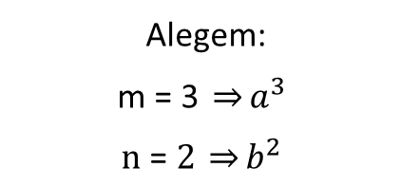

Exemplu pentru operația de împărțire
{ }
$$\{ \}$$
$${\{ a}^{m}\text{, }\text{α}\text{ \}}$$
$${\{ a}^{3}\text{α}\text{ \}}$$
$$Pasul 0$$
$${\{ b}^{n} \}$$
$${\{ b}^{2} \}$$
Alegem:
$$\text{m}\text{ = 3 }\underset{⇒}{}a^{3}$$
$$\text{n}\text{ = }2 \underset{⇒}{}b^{2}$$

Slide 5





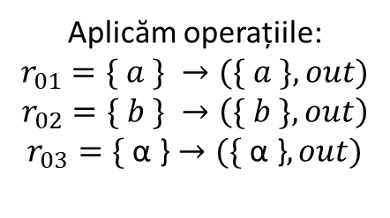



Exemplu pentru operația de împărțire
$$\{ \}$$
{ }
$${\{ a}^{3}\text{,} b^{2}\text{, }\text{α}\text{ \}}$$
$$\{ \}$$
$$\{ \}$$
$${\{ a}^{m}\text{α}\text{ \}}$$
$${\{ a}^{3}\text{α}\text{ \}}$$
$${\{ a}^{3}\text{α}\text{ \}}$$
$$Pasul 1$$
$${\{ b}^{n} \}$$
$${\{ b}^{2} \}$$
$${\{ b}^{2} \}$$
$$\{ \}$$
Aplicăm operațiile:
$$r_{01}=\{ a \} →(\{ a \}, out)$$
$$r_{02}=\{ b \} →\left(\{ b \}, out\right)$$
$$r_{03}=\text{\{ }\text{α}\text{ \}}→(\text{\{ }\text{α}\text{ \}}, out)$$

Slide 6





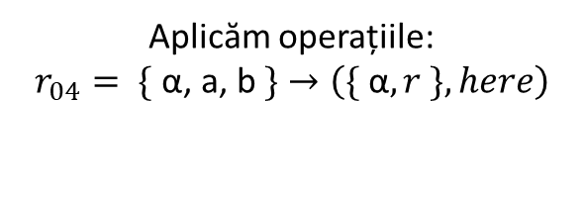


Exemplu pentru operația de împărțire
$$\{ \}$$
$${\{ a}^{2}\text{,}{ b}^{1}\text{,}{ r}^{1}\text{, }\text{α} \text{\}}$$
{ }
$${\{ a}^{3}\text{,} b^{2}\text{, }\text{α}\text{ \}}$$
$$\{ \}$$
$${\{ a}^{3}\text{,} b^{2}\text{, }\text{α}\text{ \}}$$
$$\{ \}$$
$$\{ \}$$
$$\{ \}$$
$${\{ a}^{3}\text{α}\text{ \}}$$
$${\{ a}^{m}\text{α}\text{ \}}$$
$${\{ a}^{3}\text{α}\text{ \}}$$
$$Pasul 2$$
$${\{ b}^{n} \}$$
$${\{ b}^{2} \}$$
$${\{ b}^{2} \}$$
$$\{ \}$$
$$\{ \}$$
$$\{ \}$$
Aplicăm operațiile:
$$r_{04}=\text{ \{ }\text{α}\text{, }\text{a}\text{, }\text{b} \text{\}}→\left(\{ \text{α}, r \}, here\right)$$

Slide 7




Exemplu pentru operația de împărțire
$$\{ \}$$
$${\{ a}^{2}\text{,}{ b}^{1}\text{,} \text{α}\text{,}{ r}^{1} \text{\}}$$
$${\{ a}^{1}\text{,}{ r}^{2}\text{, }\text{α}\text{\}}$$
{ }
$${\{ a}^{3}\text{,} b^{2}\text{, }\text{α}\text{ \}}$$
$$\{ \}$$
$${\{ a}^{3}\text{,} b^{2}\text{, }\text{α}\text{ \}}$$
$${\{ a}^{2}\text{,}{ b}^{1}\text{,}{ r}^{1}\text{, }\text{α} \text{\}}$$
$$\{ \}$$
$$\{ \}$$
$$\{ \}$$
$$\{ \}$$
$${\{ a}^{3}\text{α}\text{ \}}$$
$$\{ \}$$
$${\{ a}^{m}\text{α}\text{ \}}$$
$${\{ a}^{3}\text{α}\text{ \}}$$
$$Pasul \text{3}$$
$${\{ b}^{n} \}$$
$${\{ b}^{2} \}$$
$${\{ b}^{2} \}$$
$$\{ \}$$
$$\{ \}$$
$$\{ \}$$
$$\{ \}$$
$$\{ \}$$
Aplicăm operațiile:
$$r_{04}=\text{ \{ }\text{α}\text{, }\text{a}\text{, }\text{b} \text{\}}→\left(\{ \text{α}, r \}, here\right)$$

Slide 8








Exemplu pentru operația de împărțire
$${\{ a}^{1}\text{,}{ r}^{2}\text{,} β \text{\}}$$
$$\{ \}$$
$${\{ a}^{2}\text{,}{ b}^{1}\text{,} \text{α}\text{,}{ r}^{1} \text{\}}$$
$${\{ a}^{1}\text{, }\text{α}\text{,}{ r}^{2} \text{\}}$$
{ }
$${\{ a}^{3}\text{,} b^{2}\text{, }\text{α}\text{ \}}$$
$$\{ \}$$
$${\{ a}^{3}\text{,} b^{2}\text{, }\text{α}\text{ \}}$$
$${\{ a}^{2}\text{,}{ b}^{1}\text{,} \text{α}\text{,}{ r}^{1} \text{\}}$$
$${\{ a}^{1}\text{,}{ r}^{2}\text{, }\text{α}\text{\}}$$
$$\{ \}$$
$$\{ \}$$
$$\{ \}$$
$$\{ \}$$
$$\{ \}$$
$${\{ a}^{3}\text{α}\text{ \}}$$
$$\{ \}$$
$$\{ \}$$
$${\{ a}^{m}\text{α}\text{ \}}$$
$${\{ a}^{3}\text{α}\text{ \}}$$
$$Pasul \text{4}$$
$${\{ b}^{n} \}$$
$${\{ b}^{2} \}$$
$${\{ b}^{2} \}$$
$$\{ \}$$
$$\{ \}$$
$$\{ \}$$
$$\{ \}$$
$$\{ \}$$
$$\{ \}$$
$$\{ \}$$
Aplicăm operațiile:
$$r_{05}=\text{ \{ }\text{α}\text{, }\text{a}\text{, }\text{r} \text{\}}→\left(\{ β, a,r \}, here\right)$$

Slide 9






Exemplu pentru operația de împărțire
$${\{ a}^{1}\text{,} { b}^{1}\text{,}{ r}^{1}, β \text{\}}$$
$${\{ a}^{1}\text{,} β\text{,}{ r}^{1} \text{\}}$$
$$\{ \}$$
$${\{ a}^{2}\text{,}{ b}^{1}\text{,} \text{α}\text{,}{ r}^{1} \text{\}}$$
$${\{ a}^{1}\text{, }\text{α}\text{,}{ r}^{2} \text{\}}$$
{ }
$${\{ a}^{3}\text{,} b^{2}\text{, }\text{α}\text{ \}}$$
$$\{ \}$$
$${\{ a}^{3}\text{,} b^{2}\text{, }\text{α}\text{ \}}$$
$${\{ a}^{2}\text{,}{ b}^{1}\text{,} \text{α}\text{,}{ r}^{1} \text{\}}$$
$${\{ a}^{1}\text{, }\text{α}\text{,}{ r}^{2} \text{\}}$$
$${\{ a}^{1}\text{,} { r}^{2}, β \text{\}}$$
$$\{ \}$$
$$\{ \}$$
$$\{ \}$$
$$\{ \}$$
$$\{ \}$$
$$\{ \}$$
$${\{ a}^{3}\text{α}\text{ \}}$$
$$\{ \}$$
$$\{ \}$$
$$\{ \}$$
$${\{ a}^{m}\text{α}\text{ \}}$$
$${\{ a}^{3}\text{α}\text{ \}}$$
$$Pasul \text{5}$$
$${\{ b}^{n} \}$$
$${\{ b}^{2} \}$$
$${\{ b}^{2} \}$$
$$\{ \}$$
$$\{ \}$$
$$\{ \}$$
$$\{ \}$$
$$\{ \}$$
$$\{ \}$$
$$\{ \}$$
$$\{ \}$$
$$\{ \}$$
Aplicăm operațiile:
$$r_{10}=\text{ \{} β, r \text{\}}→\left(\{ β,b \}, here\right)$$

Slide 10






Exemplu pentru operația de împărțire
$${\{ a}^{1}\text{,} { b}^{2}, β \text{\}}$$
$${\{ a}^{1}\text{,} β\text{,}{ r}^{1} \text{\}}$$
$$\{ \}$$
$${\{ a}^{2}\text{,}{ b}^{1}\text{,} \text{α}\text{,}{ r}^{1} \text{\}}$$
$${\{ a}^{1}\text{, }\text{α}\text{,}{ r}^{2} \text{\}}$$
$${\{ a}^{1}\text{,} { b}^{1}\text{,}{ r}^{1}\text{,} β \text{\}}$$
$${\{ a}^{3}\text{,} b^{2}\text{, }\text{α}\text{ \}}$$
{ }
$$\{ \}$$
$${\{ a}^{3}\text{,} b^{2}\text{, }\text{α}\text{ \}}$$
$${\{ a}^{2}\text{,}{ b}^{1}\text{,} \text{α}\text{,}{ r}^{1} \text{\}}$$
$${\{ a}^{1}\text{, }\text{α}\text{,}{ r}^{2} \text{\}}$$
$${\{ a}^{1}\text{,} β\text{,}{ r}^{1} \text{\}}$$
$$\{ \}$$
$$\{ \}$$
$$\{ \}$$
$$\{ \}$$
$$\{ \}$$
$$\{ \}$$
$${\{ a}^{3}\text{α}\text{ \}}$$
$$\{ \}$$
$$\{ \}$$
$$\{ \}$$
$$\{ \}$$
$${\{ a}^{m}\text{α}\text{ \}}$$
$${\{ a}^{3}\text{α}\text{ \}}$$
$$Pasul \text{6}$$
$${\{ b}^{n} \}$$
$${\{ b}^{2} \}$$
$${\{ b}^{2} \}$$
$$\{ \}$$
$$\{ \}$$
$$\{ \}$$
$$\{ \}$$
$$\{ \}$$
$$\{ \}$$
$$\{ \}$$
$$\{ \}$$
$$\{ \}$$
$$\{ \}$$
Aplicăm operațiile:
$$r_{10}=\text{ \{} β, r \text{\}}→\left(\{ β,b \}, here\right)$$

Slide 11







Exemplu pentru operația de împărțire
$${\{ a}^{1}\text{,} { b}^{2},{ c}^{1},α \text{\}}$$
$${\{ a}^{1}\text{,} β\text{,}{ r}^{1} \text{\}}$$
$$\{ \}$$
$${\{ a}^{2}\text{,}{ b}^{1}\text{,} \text{α}\text{,}{ r}^{1} \text{\}}$$
$${\{ a}^{1}\text{, }\text{α}\text{,}{ r}^{2} \text{\}}$$
$${\{ a}^{1}\text{,} { b}^{1}, β\text{,}{ r}^{1} \text{\}}$$
$${\{ a}^{3}\text{,} b^{2}\text{, }\text{α}\text{ \}}$$
{ }
$$\{ \}$$
$${\{ a}^{3}\text{,} b^{2}\text{, }\text{α}\text{ \}}$$
$${\{ a}^{2}\text{,}{ b}^{1}\text{,} \text{α}\text{,}{ r}^{1} \text{\}}$$
$${\{ a}^{1}\text{, }\text{α}\text{,}{ r}^{2} \text{\}}$$
$${\{ a}^{1}\text{,} β\text{,}{ r}^{1} \text{\}}$$
$${\{ a}^{1}\text{,} { b}^{2}, β \text{\}}$$
$$\{ \}$$
$$\{ \}$$
$$\{ \}$$
$$\{ \}$$
$$\{ \}$$
$$\{ \}$$
$${\{ a}^{3}\text{α}\text{ \}}$$
$$\{ \}$$
$$\{ \}$$
$$\{ \}$$
$$\{ \}$$
$${\{ a}^{m}\text{α}\text{ \}}$$
$${\{ a}^{3}\text{α}\text{ \}}$$
$$\{ \}$$
$$Pasul 7$$
$${\{ b}^{n} \}$$
$${\{ b}^{2} \}$$
$${\{ b}^{2} \}$$
$$\{ \}$$
$$\{ \}$$
$$\{ \}$$
$$\{ \}$$
$$\{ \}$$
$$\{ \}$$
$$\{ \}$$
$$\{ \}$$
$$\{ \}$$
$$\{ \}$$
$$\{ \}$$
Aplicăm operațiile:
$$r_{11}=\text{ \{} β \text{\}}→\left(\{ \text{α}\text{, }\text{c} \}, here\right)$$

Slide 12






Exemplu pentru operația de împărțire
$$\{{ b}^{1},{ c}^{1},{ r}^{1}, α\text{\}}$$
$${\{ a}^{1}\text{,} β\text{,}{ r}^{1} \text{\}}$$
$$\{ \}$$
$${\{ a}^{2}\text{,}{ b}^{1}\text{,} \text{α}\text{,}{ r}^{1} \text{\}}$$
$${\{ a}^{1}\text{, }\text{α}\text{,}{ r}^{2} \text{\}}$$
$${\{ a}^{1}\text{,} { b}^{1}, β\text{,}{ r}^{1} \text{\}}$$
$${\{ a}^{3}\text{,} b^{2}\text{, }\text{α}\text{ \}}$$
{ }
$$\{ \}$$
$${\{ a}^{3}\text{,} b^{2}\text{, }\text{α}\text{ \}}$$
$${\{ a}^{2}\text{,}{ b}^{1}\text{,} \text{α}\text{,}{ r}^{1} \text{\}}$$
$${\{ a}^{1}\text{, }\text{α}\text{,}{ r}^{2} \text{\}}$$
$${\{ a}^{1}\text{,} β\text{,}{ r}^{1} \text{\}}$$
$${\{ a}^{1}\text{,} { b}^{2}, β \text{\}}$$
$${\{ a}^{1}\text{,} { b}^{2},{ c}^{1},α \text{\}}$$
$$\{ \}$$
$$\{ \}$$
$$\{ \}$$
$$\{ \}$$
$$\{ \}$$
$$\{ \}$$
$${\{ a}^{3}\text{α}\text{ \}}$$
$$\{ \}$$
$$\{ \}$$
$$\{ \}$$
$$\{ \}$$
$${\{ a}^{m}\text{α}\text{ \}}$$
$${\{ a}^{3}\text{α}\text{ \}}$$
$$\{ \}$$
$$\{ \}$$
$$Pasul 8$$
$${\{ b}^{n} \}$$
$${\{ b}^{2} \}$$
$${\{ b}^{2} \}$$
$$\{ \}$$
$$\{ \}$$
$$\{ \}$$
$$\{ \}$$
$$\{ \}$$
$$\{ \}$$
$$\{ \}$$
$$\{ \}$$
$$\{ \}$$
$$\{ \}$$
$$\{ \}$$
$$\{ \}$$
Aplicăm operațiile:
$$r_{04}=\text{ \{ }\text{α}\text{, }\text{a}\text{, }\text{b} \text{\}}→\left(\{ \text{α}, r \}, here\right)$$

Slide 13




Exemplu pentru operația de împărțire
$$\{{ b}^{1},{ c}^{1},{ r}^{1},γ\text{\}}$$
$${\{ a}^{1}\text{,} β\text{,}{ r}^{1} \text{\}}$$
$$\{ \}$$
$${\{ a}^{2}\text{,}{ b}^{1}\text{,} \text{α}\text{,}{ r}^{1} \text{\}}$$
$${\{ a}^{1}\text{, }\text{α}\text{,}{ r}^{2} \text{\}}$$
$${\{ a}^{1}\text{,} { b}^{1}, β\text{,}{ r}^{1} \text{\}}$$
$${\{ a}^{3}\text{,} b^{2}\text{, }\text{α}\text{ \}}$$
{ }
$$\{ \}$$
$${\{ a}^{3}\text{,} b^{2}\text{, }\text{α}\text{ \}}$$
$${\{ a}^{2}\text{,}{ b}^{1}\text{,} \text{α}\text{,}{ r}^{1} \text{\}}$$
$${\{ a}^{1}\text{, }\text{α}\text{,}{ r}^{2} \text{\}}$$
$${\{ a}^{1}\text{,} β\text{,}{ r}^{1} \text{\}}$$
$${\{ a}^{1}\text{,} { b}^{2}, β \text{\}}$$
$$\{{ b}^{1},{ c}^{1},{ r}^{1}, α \text{\}}$$
$${\{ a}^{1}\text{,} { b}^{2},{ c}^{1},α \text{\}}$$
$$\{ \}$$
$$\{ \}$$
$$\{ \}$$
$$\{ \}$$
$$\{ \}$$
$$\{ \}$$
$${\{ a}^{3}\text{α}\text{ \}}$$
$$\{ \}$$
$$\{ \}$$
$$\{ \}$$
$$\{ \}$$
$${\{ a}^{m}\text{α}\text{ \}}$$
$${\{ a}^{3}\text{α}\text{ \}}$$
$$\{ \}$$
$$\{ \}$$
$$\{ \}$$
$$Pasul 9$$
$${\{ b}^{n} \}$$
$${\{ b}^{2} \}$$
$${\{ b}^{2} \}$$
$$\{ \}$$
$$\{ \}$$
$$\{ \}$$
$$\{ \}$$
$$\{ \}$$
$$\{ \}$$
$$\{ \}$$
$$\{ \}$$
$$\{ \}$$
$$\{ \}$$
$$\{ \}$$
$$\{ \}$$
$$\{ \}$$
Aplicăm operațiile:
$$r_{07}=\text{ \{ }\text{α}\text{, }\text{b} \text{\}}→\left(\{ γ, b \}, here\right)$$

Slide 14




Exemplu pentru operația de împărțire
$$FINAL$$
$$\{{ b}^{1},{ c}^{1},{ r}^{1},γ\text{\}}$$
$${\{ a}^{1}\text{,} β\text{,}{ r}^{1} \text{\}}$$
$$\{ \}$$
$${\{ a}^{2}\text{,}{ b}^{1}\text{,} \text{α}\text{,}{ r}^{1} \text{\}}$$
$${\{ a}^{1}\text{, }\text{α}\text{,}{ r}^{2} \text{\}}$$
$$\{{ b}^{1},{ c}^{1},{ r}^{1},γ\text{\}}$$
$${\{ a}^{3}\text{,} b^{2}\text{, }\text{α}\text{ \}}$$
$${\{ a}^{1}\text{,} { b}^{1}, β\text{,}{ r}^{1} \text{\}}$$
{ }
$$\{ \}$$
$${\{ a}^{3}\text{,} b^{2}\text{, }\text{α}\text{ \}}$$
$${\{ a}^{2}\text{,}{ b}^{1}\text{,} \text{α}\text{,}{ r}^{1} \text{\}}$$
$${\{ a}^{1}\text{, }\text{α}\text{,}{ r}^{2} \text{\}}$$
$${\{ a}^{1}\text{,} β\text{,}{ r}^{1} \text{\}}$$
$${\{ a}^{1}\text{,} { b}^{2}, β \text{\}}$$
$$\{{ b}^{1},{ c}^{1},{ r}^{1}, α \text{\}}$$
$${\{ a}^{1}\text{,} { b}^{2},{ c}^{1},α \text{\}}$$
$$\{ \}$$
$$\{ \}$$
$$\{ \}$$
$$\{ \}$$
$$\{ \}$$
$$\{ \}$$
$${\{ a}^{3}\text{α}\text{ \}}$$
$$\{ \}$$
$$\{ \}$$
$$\{ \}$$
$$\{ \}$$
$$\{ \}$$
$${\{ a}^{m}\text{α}\text{ \}}$$
$${\{ a}^{3}\text{α}\text{ \}}$$
$$\{ \}$$
$$\{ \}$$
$$\{ \}$$
$$Pasul 10$$
$${\{ b}^{n} \}$$
$${\{ b}^{2} \}$$
$${\{ b}^{2} \}$$
$$\{ \}$$
$$\{ \}$$
$$\{ \}$$
$$\{ \}$$
$$\{ \}$$
$$\{ \}$$
$$\{ \}$$
$$\{ \}$$
$$\{ \}$$
$$\{ \}$$
$$\{ \}$$
$$\{ \}$$
$$\{ \}$$
$$\{ \}$$
Aplicăm operațiile:
$$r_{07}=\text{ \{ }\text{α}\text{, }\text{b} \text{\}}→\left(\{ γ, b \}, here\right)$$

Slide 15
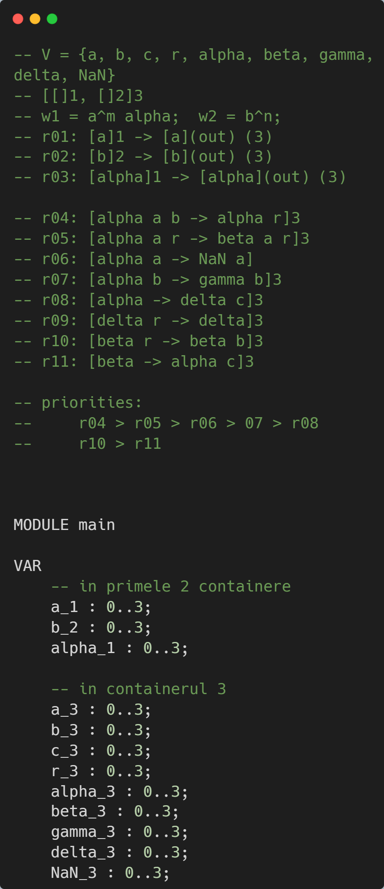
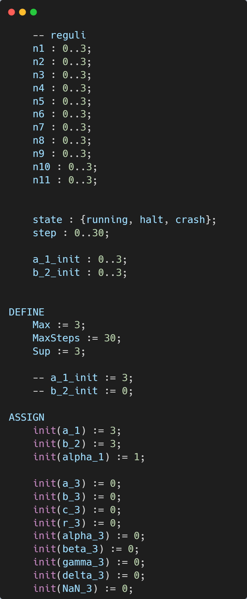
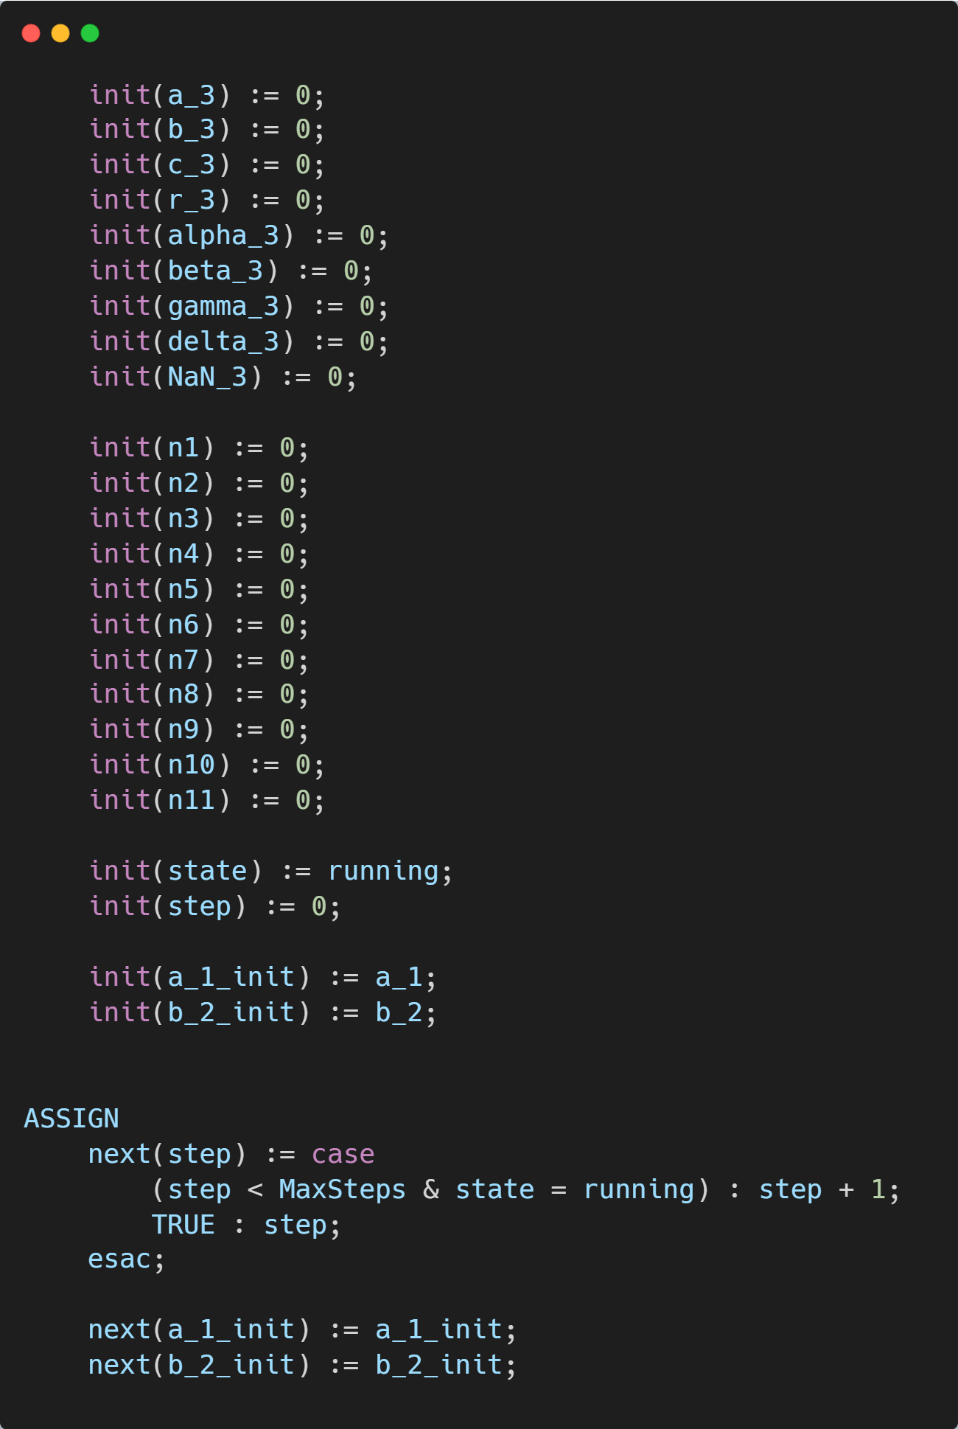
Codul NuSMV pentru operația de împărțire

Slide 16
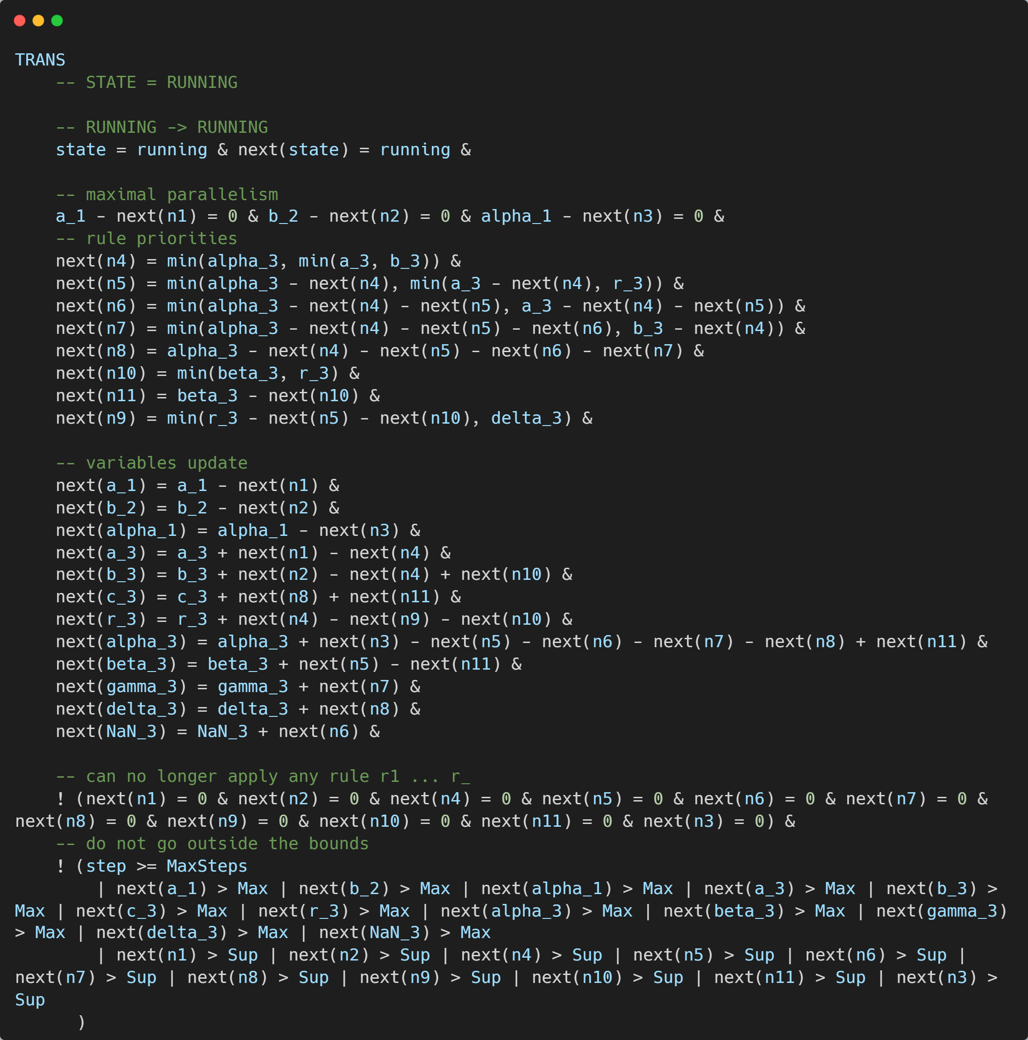
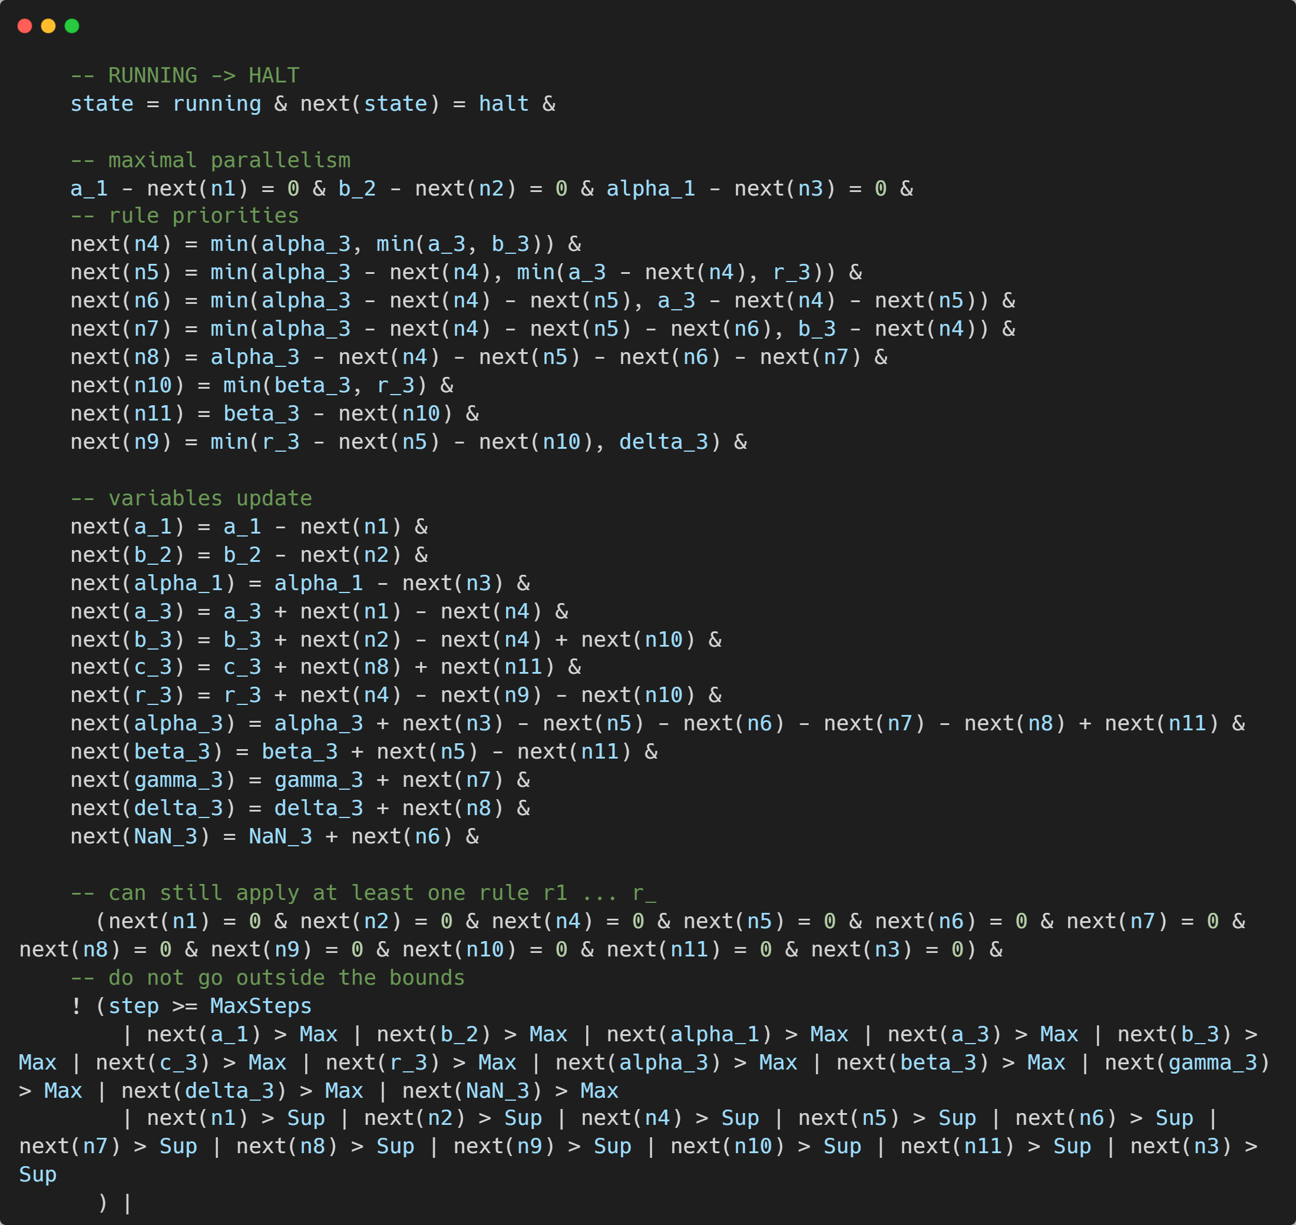

Slide 17
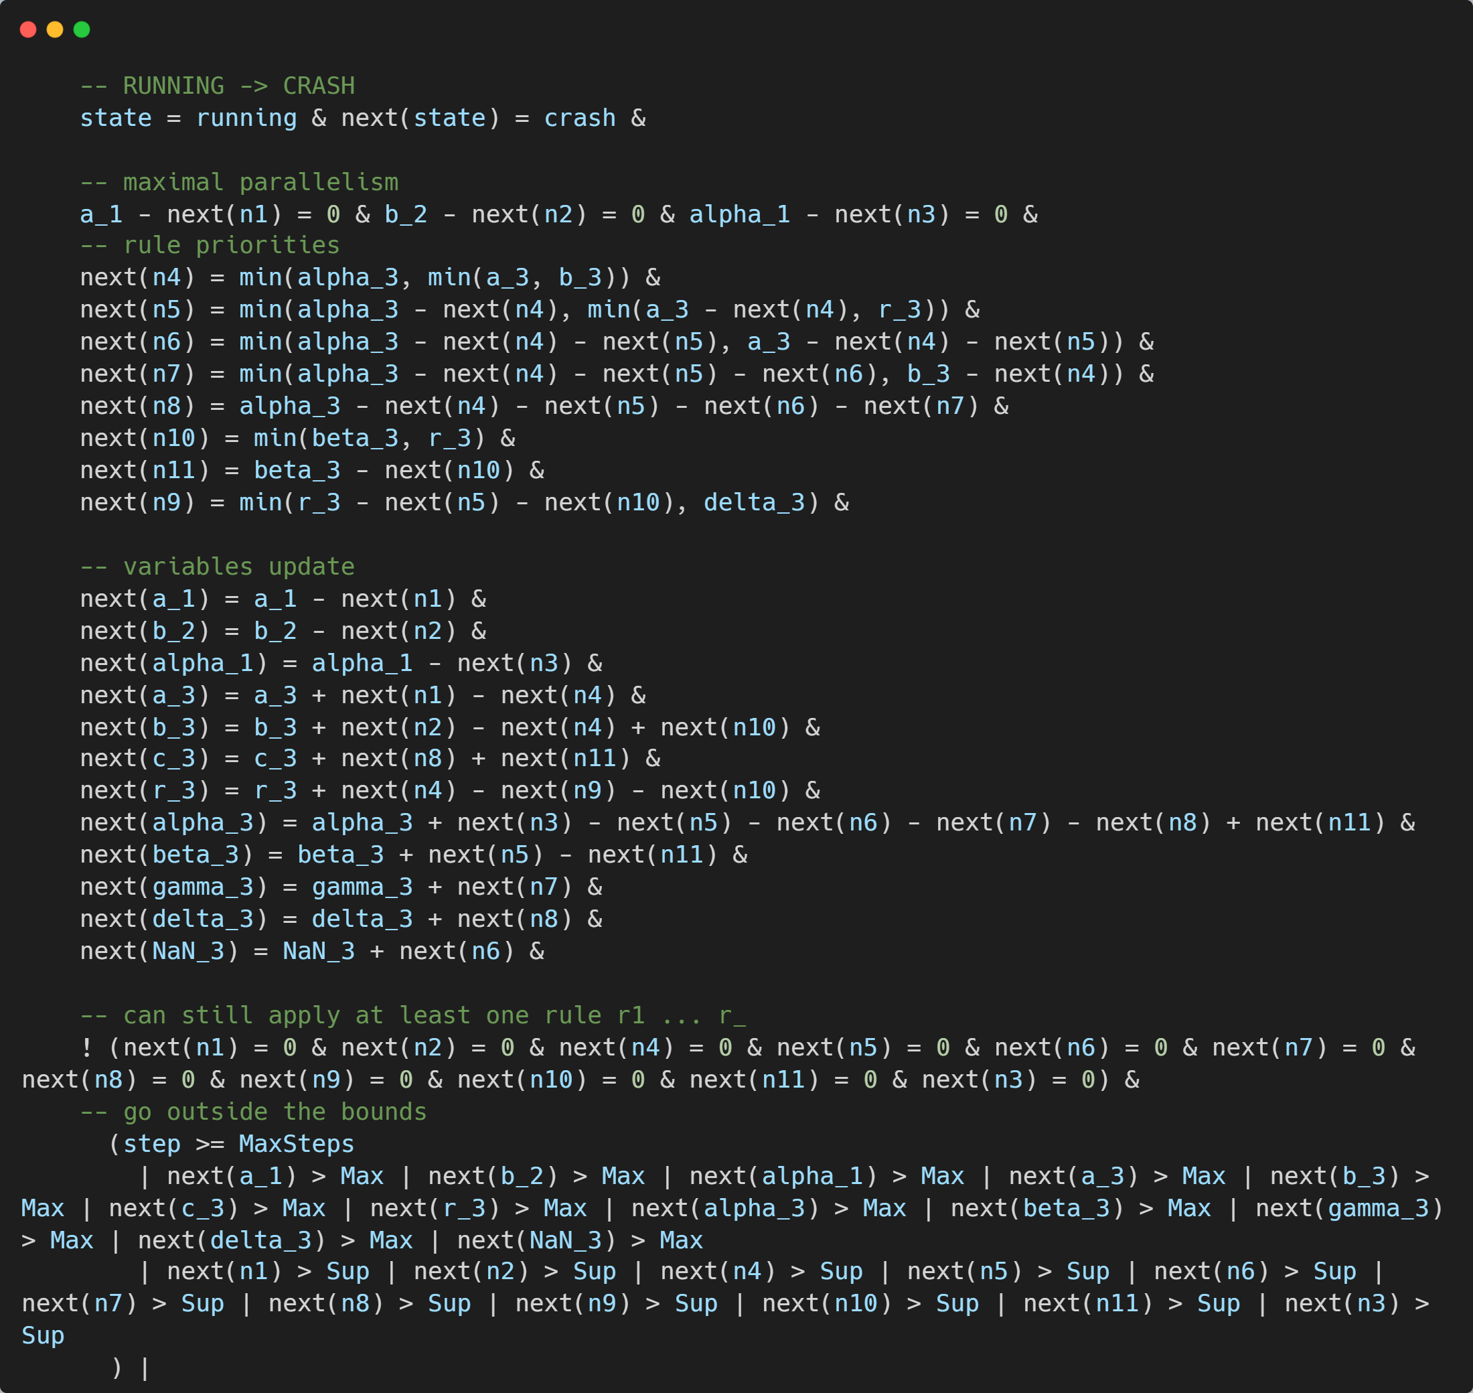

Slide 18
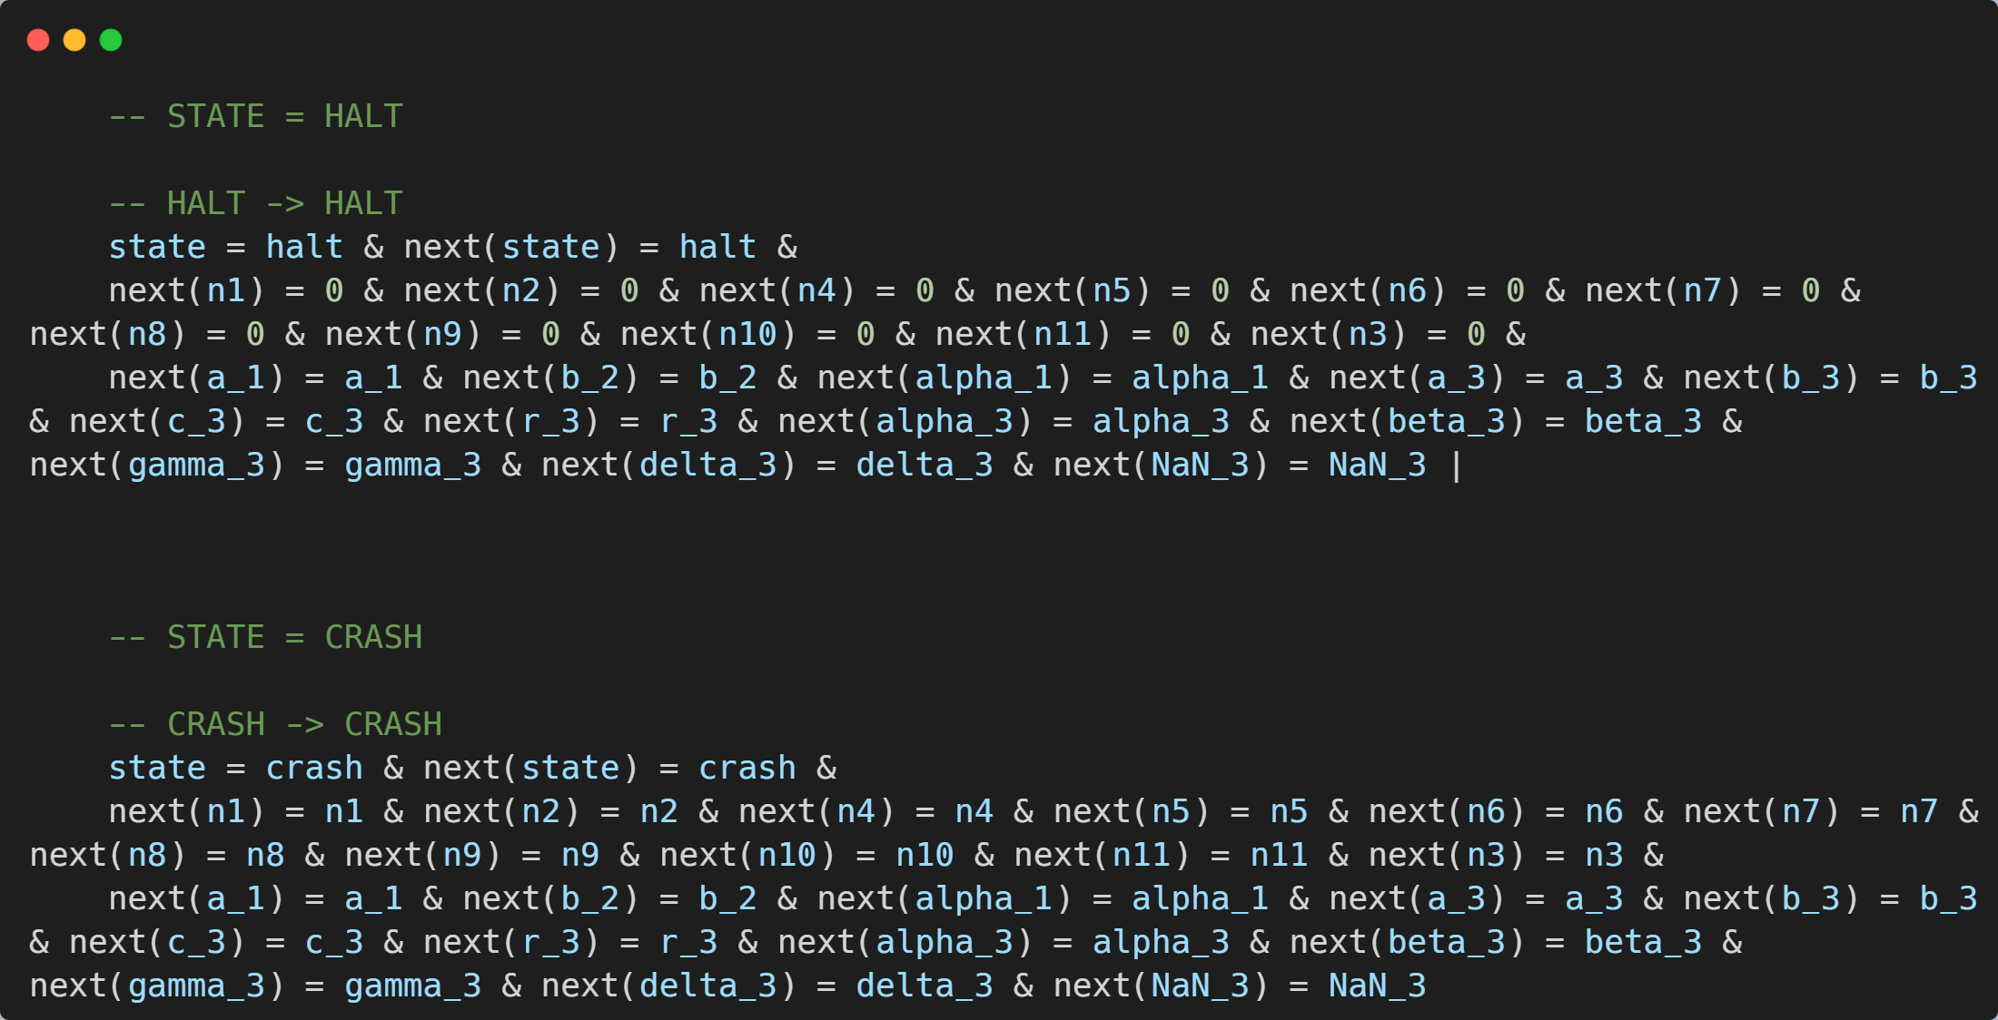

Slide 19
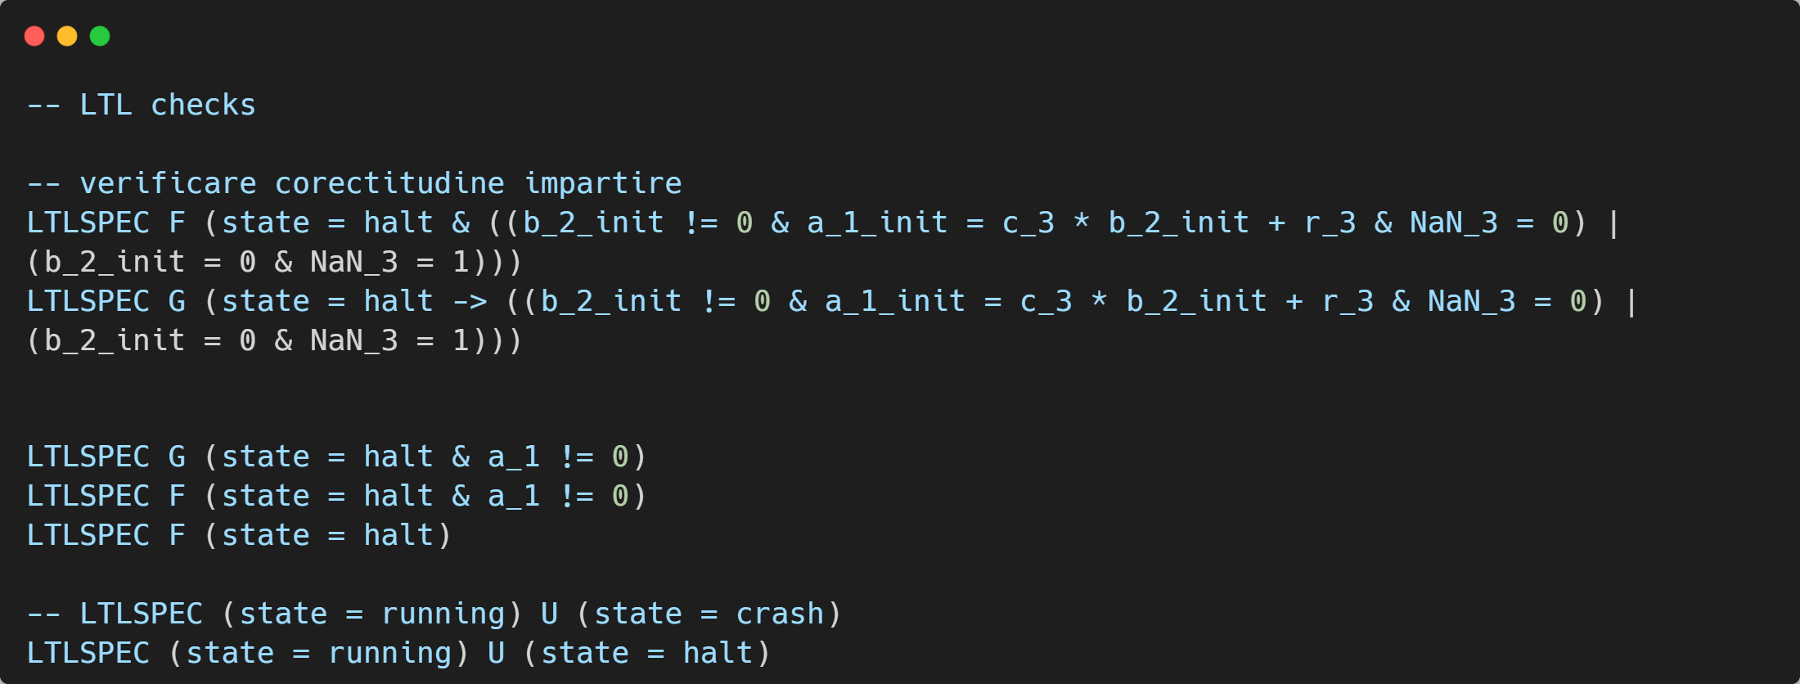

Slide 21
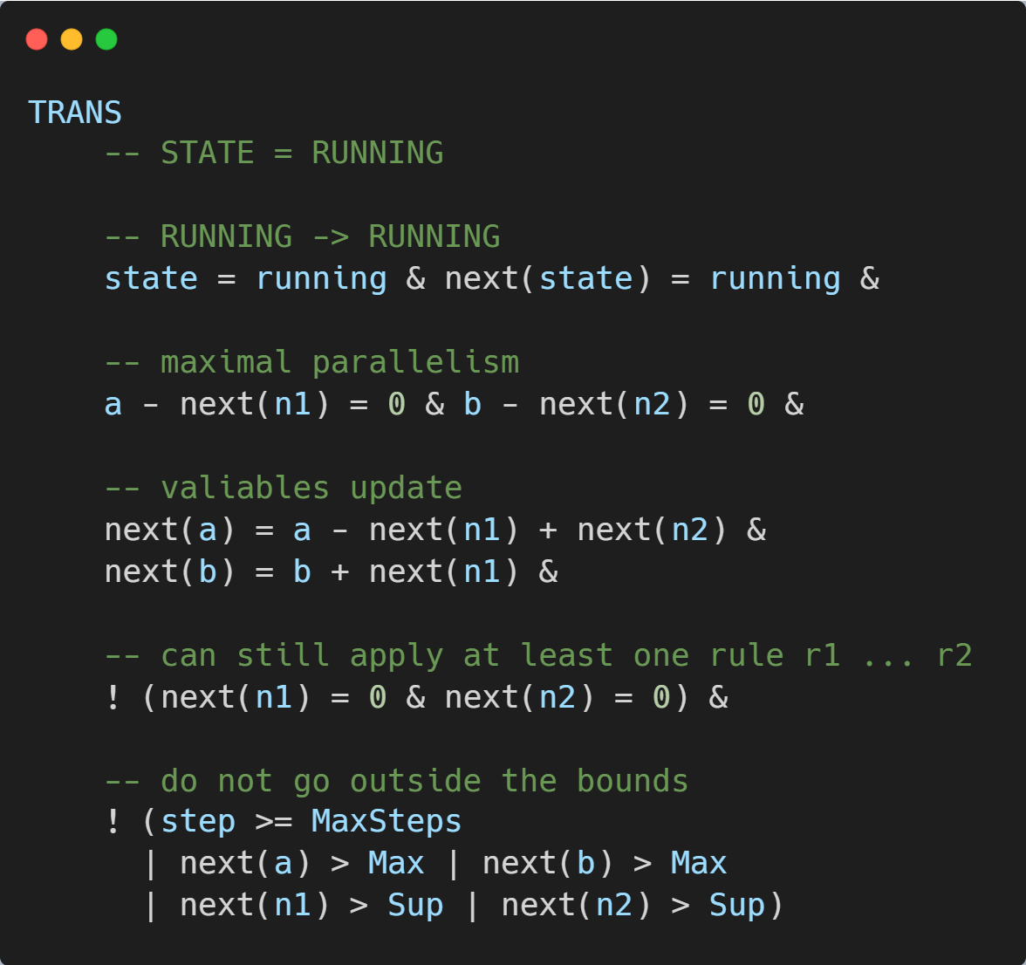
Codul NuSMV pentru numerele Fibonacci

Slide 22
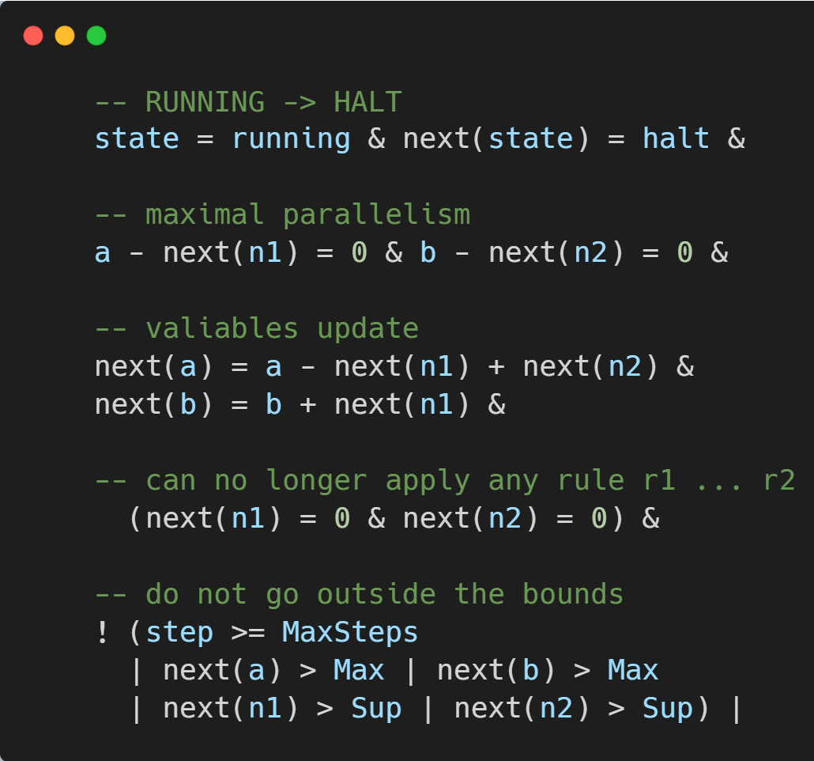
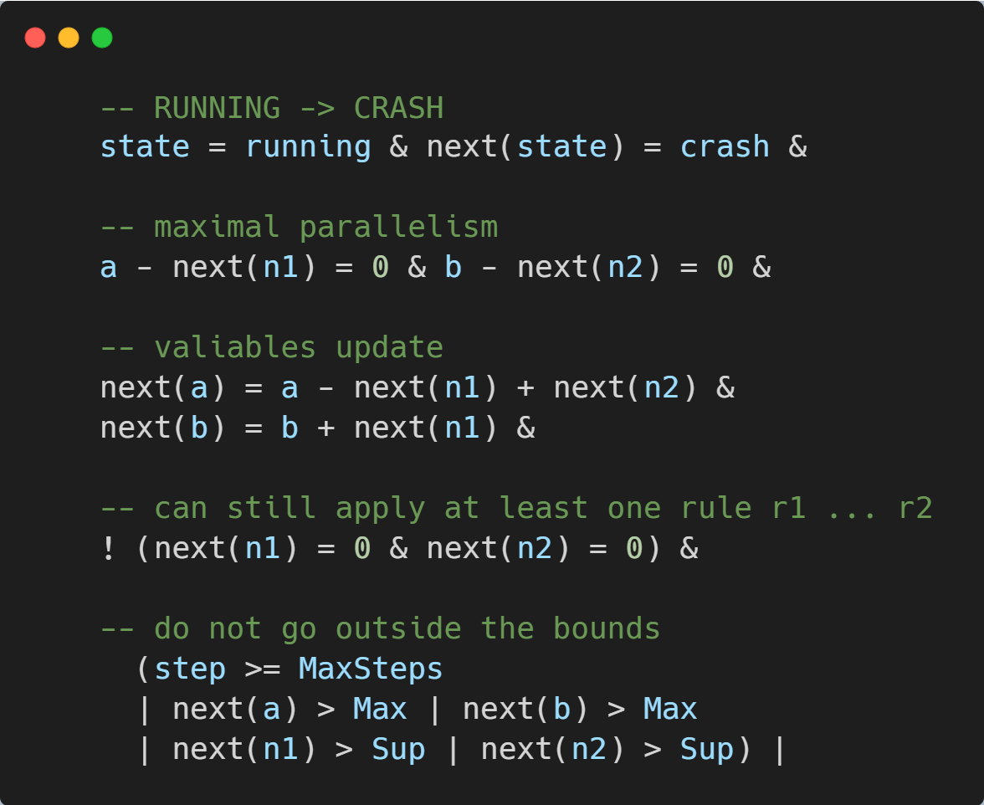

Slide 23
